Slide 1
Online Book Store
Group: IS-1812k
Kipchakpayev Madiyar

Slide 2
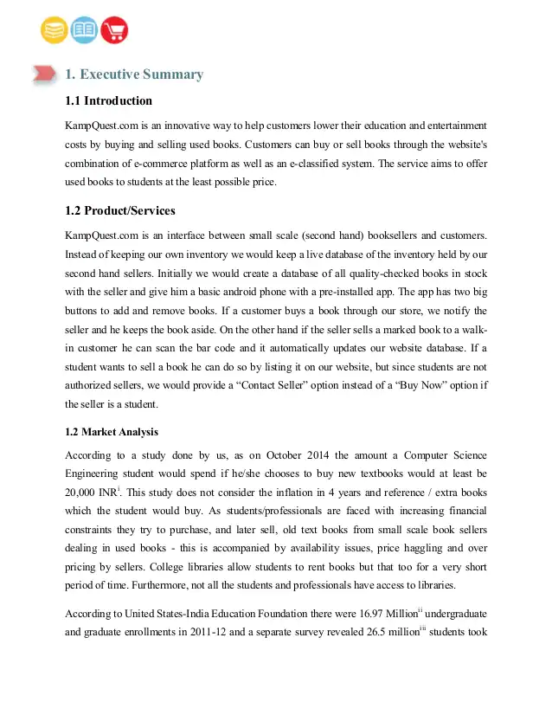

Slide 3
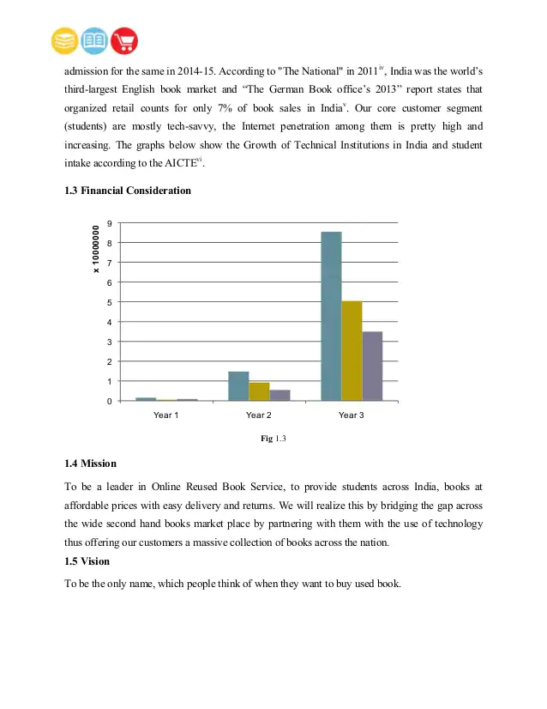
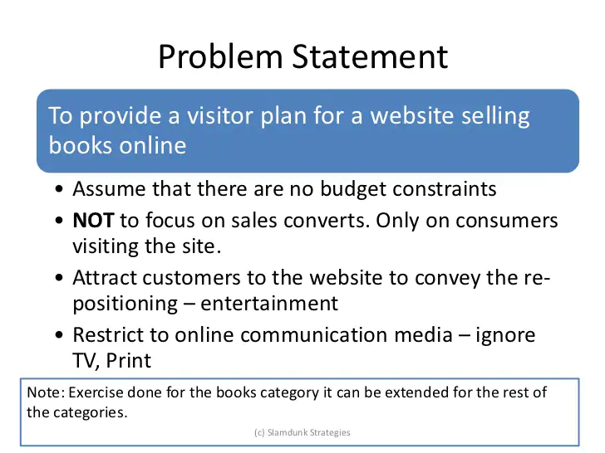

Slide 4
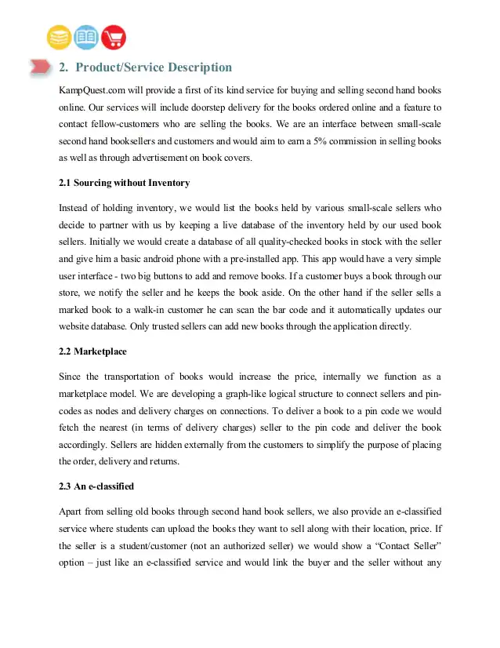
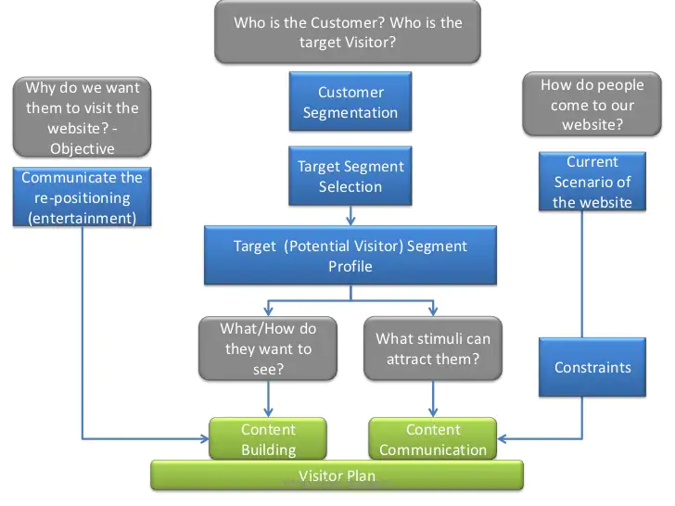

Slide 5
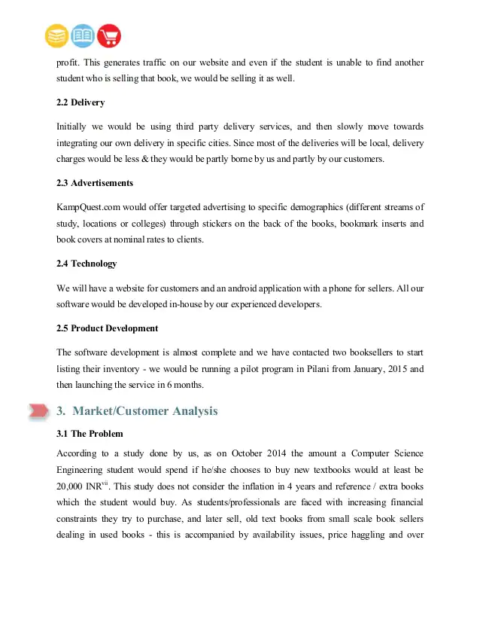

Slide 6
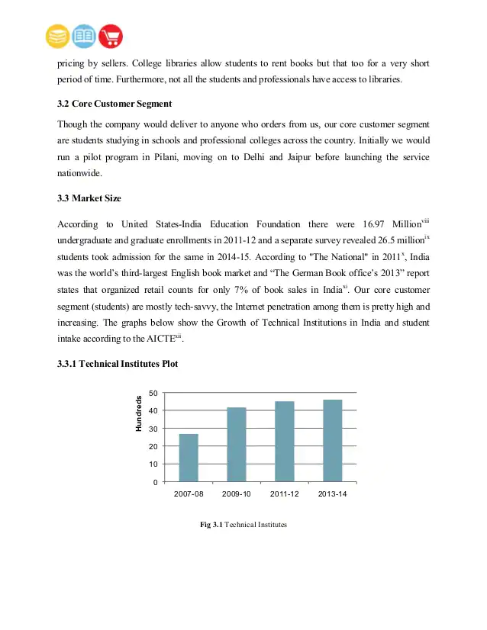
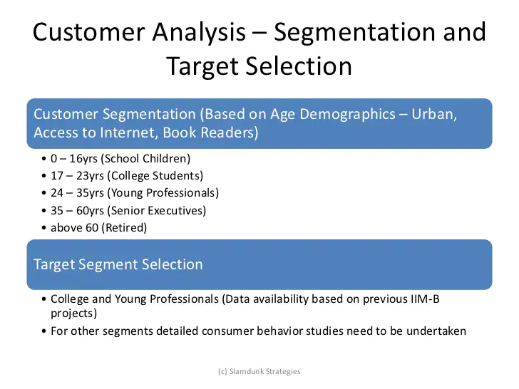

Slide 7
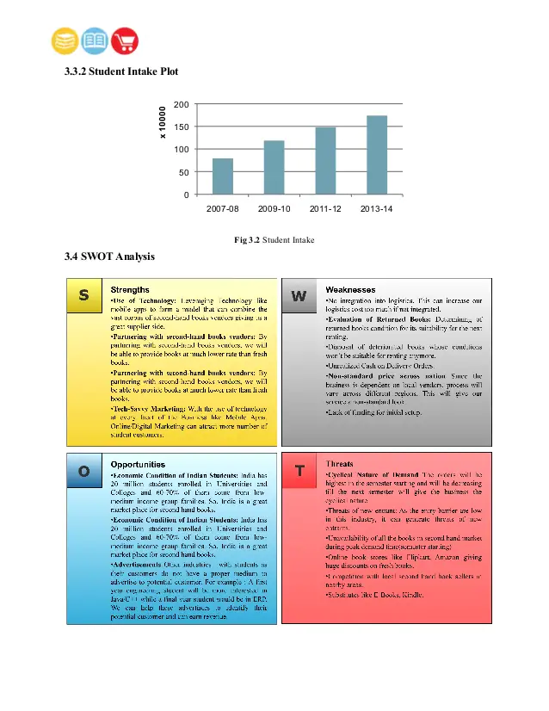
SWOT ANALYSIS OF ONLINE BOOK STORE:
Strengths:
Use of Internet as a Storefront for Books services.
Customer Convenience.
Less Investment & fewer workforces for starting the venture.
Target market.
Minimum physical assets & less overhead charges on warehouses.
Cost effectiveness to the customers.
Post sales service of informing customers about new products & new auctions
Weaknesses:
Supply of Books out of stock.
Confined to Assam only.
Dependent on external delivery services of courier services.
Need Constant maintenance of website.
Opportunities:
Online Bookstore.
Just a click away.
To develop relationship with Publishers to offer exclusive editions..
Collaborations with public sectors to provide rare & antique books.
Threats:
Local Bookshop vendors.
Price competition/war.
Increase in the Transportation costs by the courier company.
Low consumer confidence to buy using online systems.
Monopoly in Online business held by some players

Slide 8
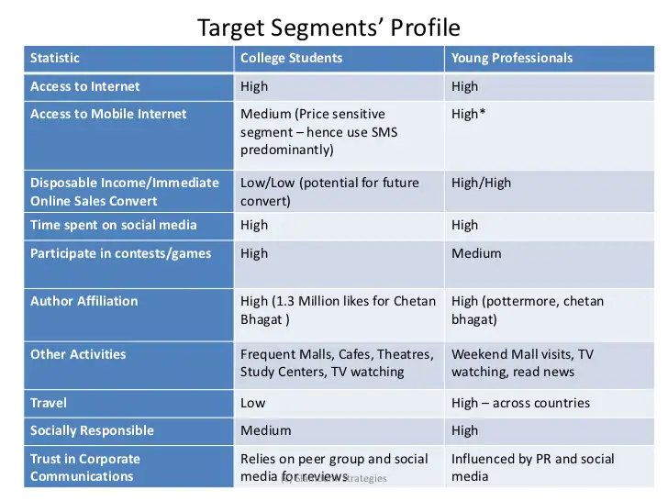
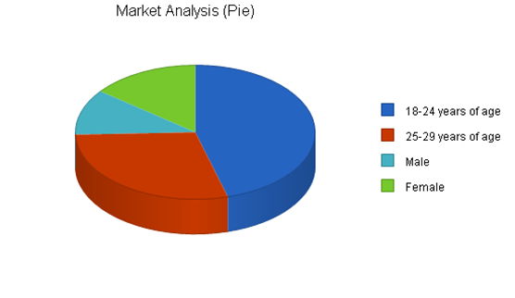

Slide 9
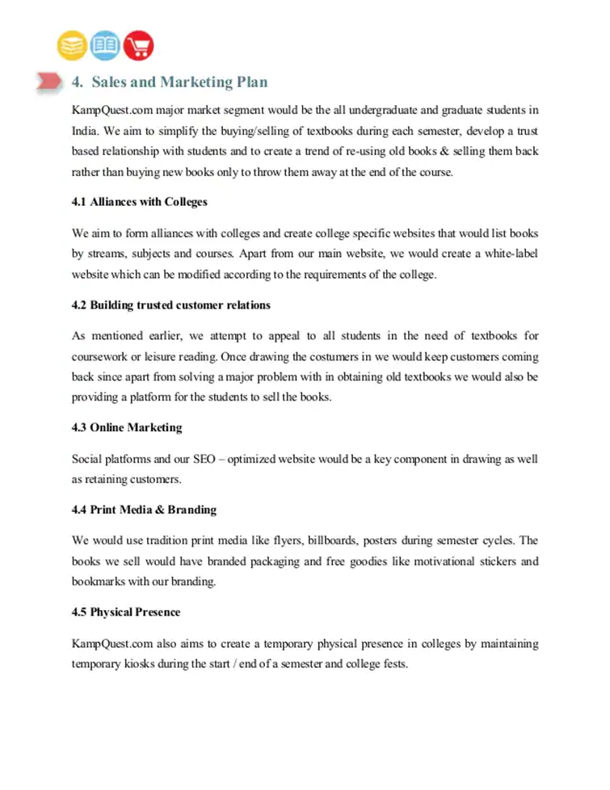
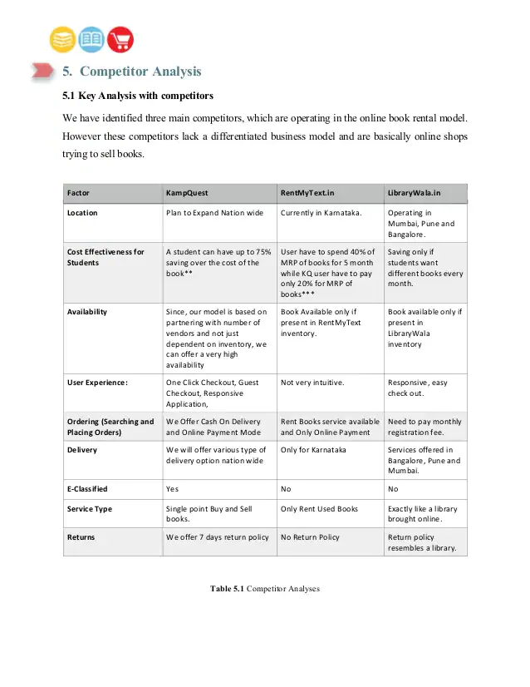

Slide 10
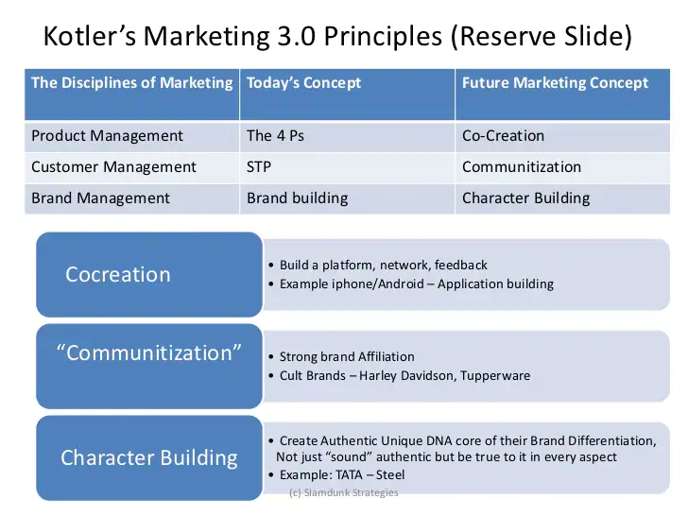
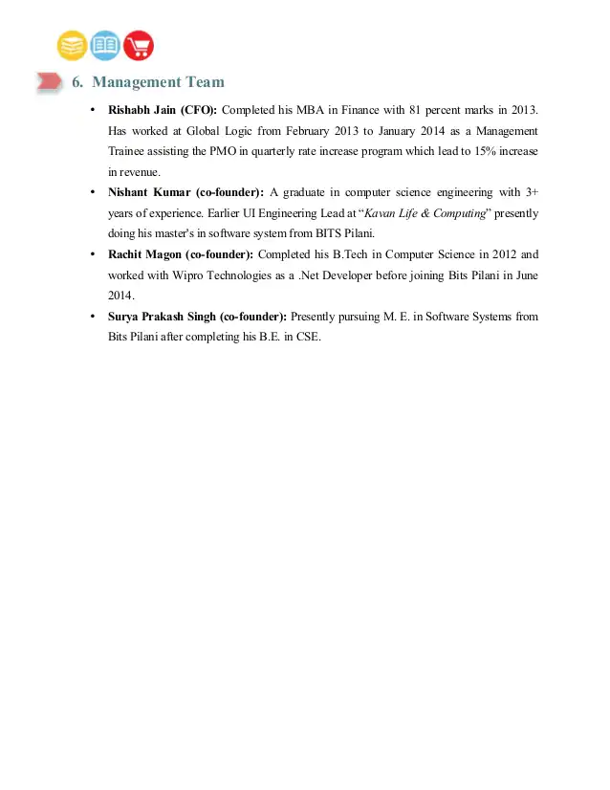

Slide 11
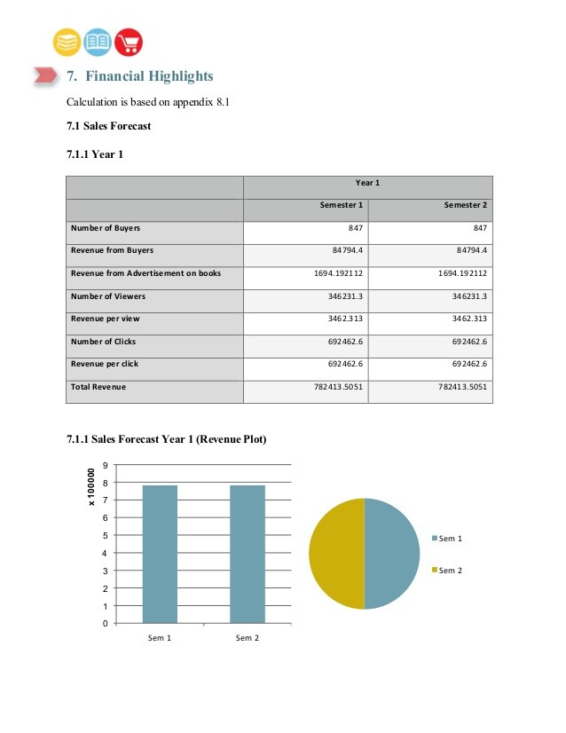
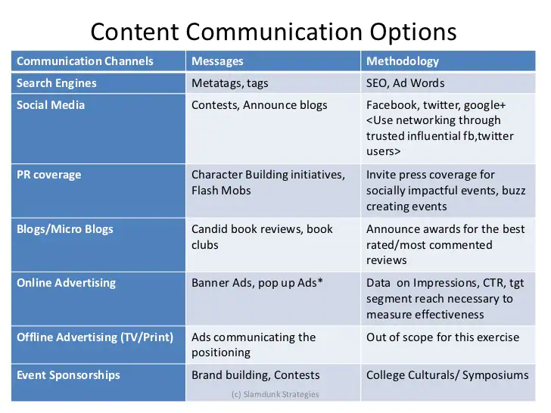

Slide 12
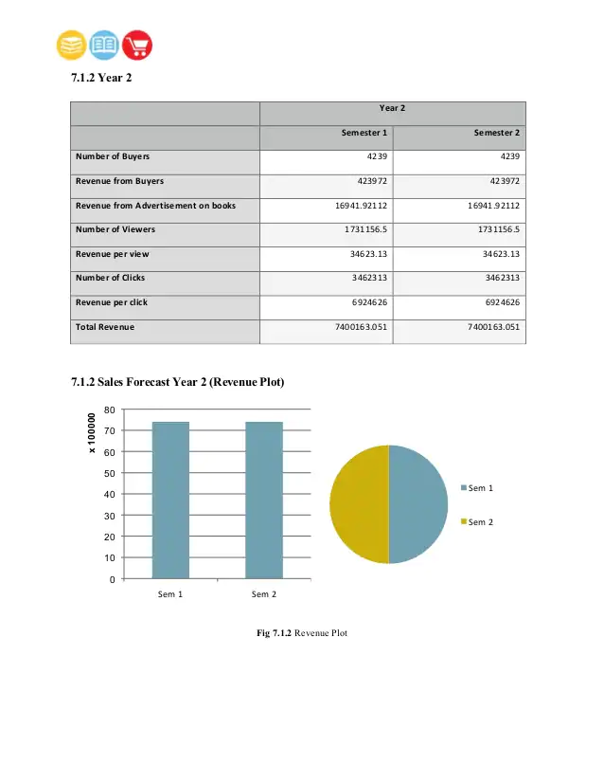

Slide 13
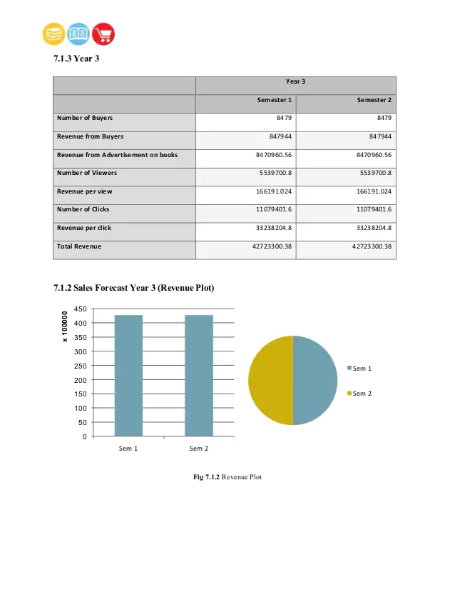

Slide 14
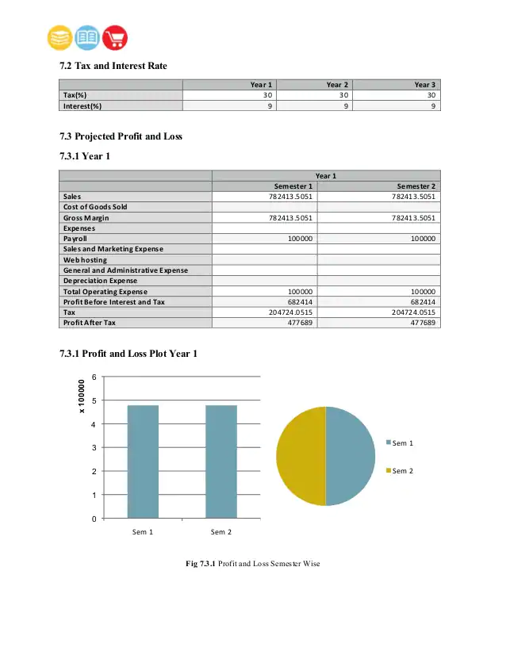

Slide 15
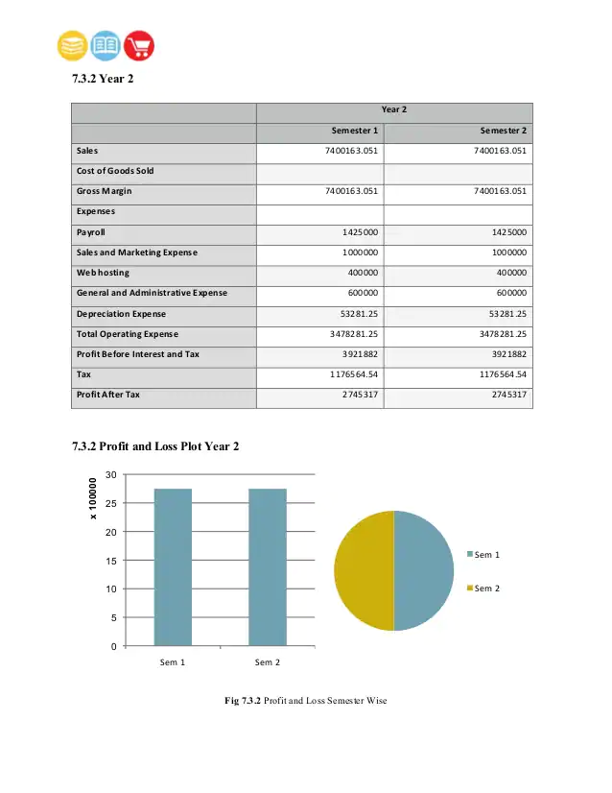

Slide 16


Slide 17
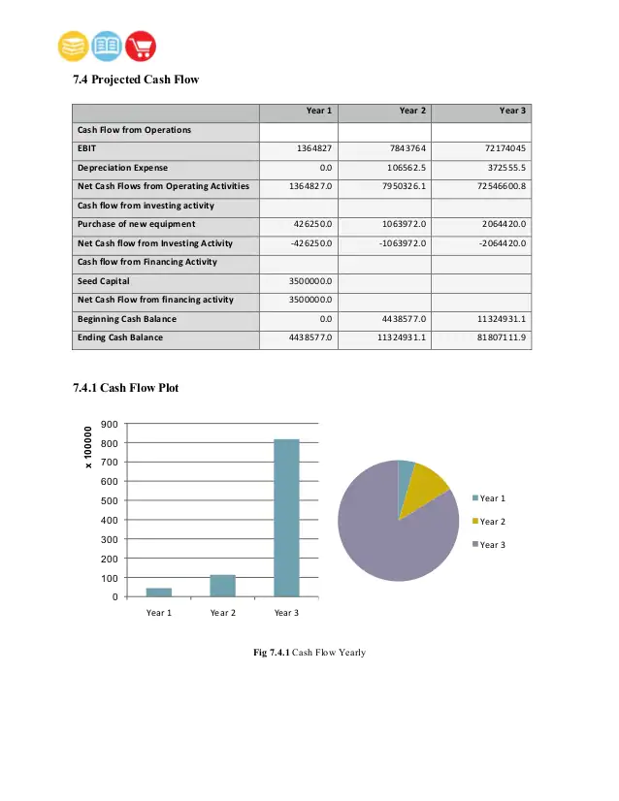

Slide 18
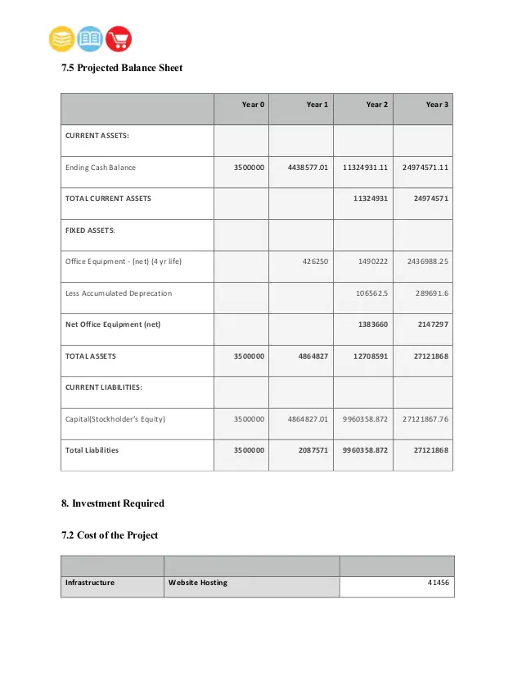

Slide 19
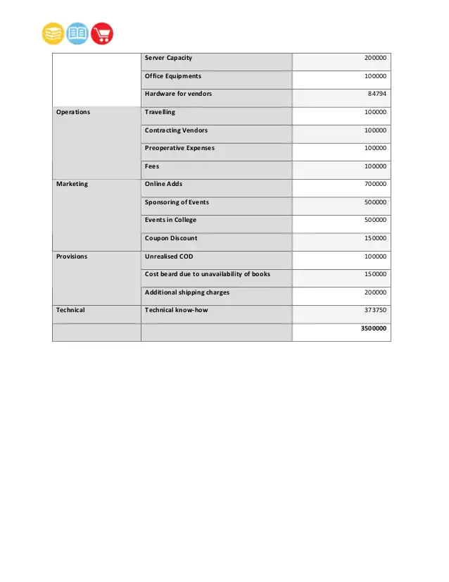

Slide 20
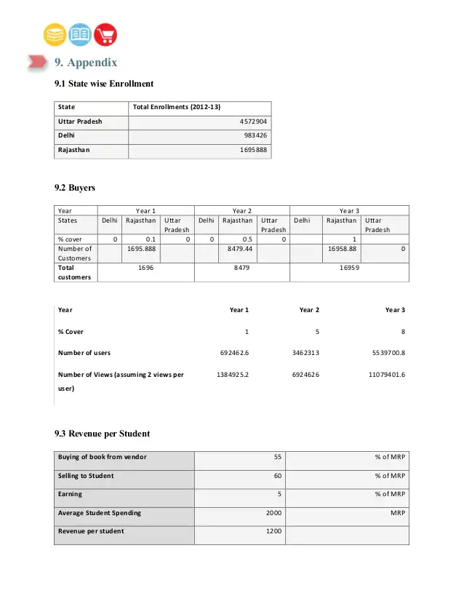

Slide 21
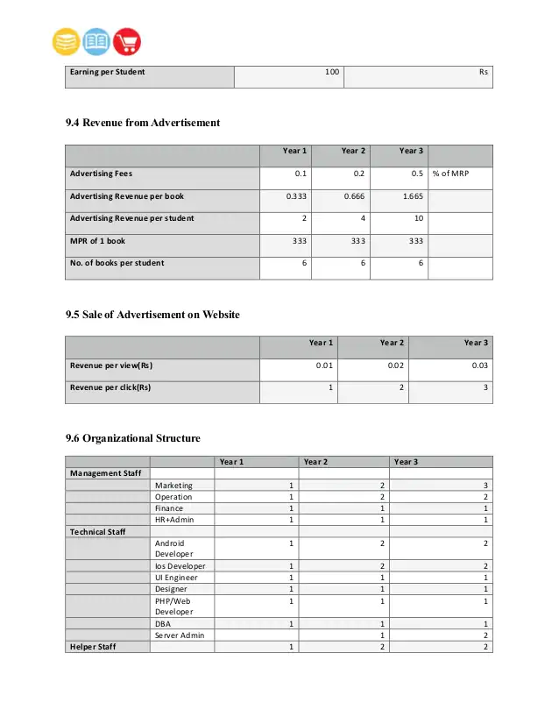
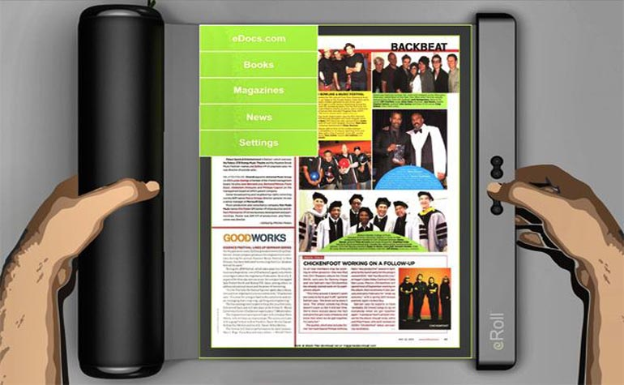


Slide 23
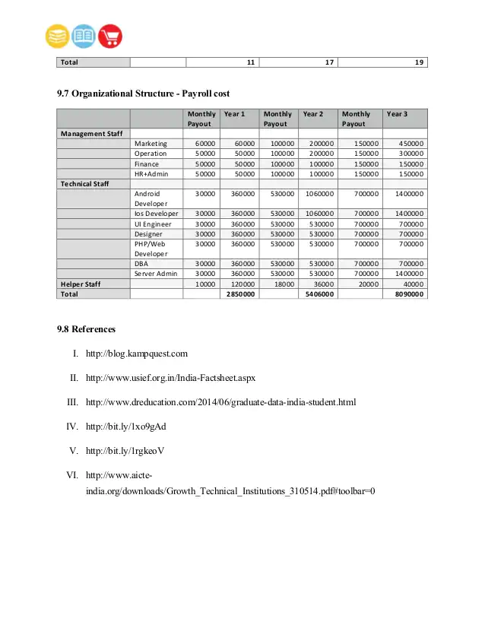

Slide 24


